Slide 1
Chapter 3 Typologies of Health and Wellness in Hospitality and Tourism
Dr. Bendegul Okumus
Heather Linton Kelly

Slide 2
Learning Outcomes
Define and discuss the full spectrum of health and wellness tourism
Define spas and thermal/mineral springs
Define yoga and meditation practices
Define spiritual tourism, and holistic tourism
Define and discuss occupational wellness

Slide 3
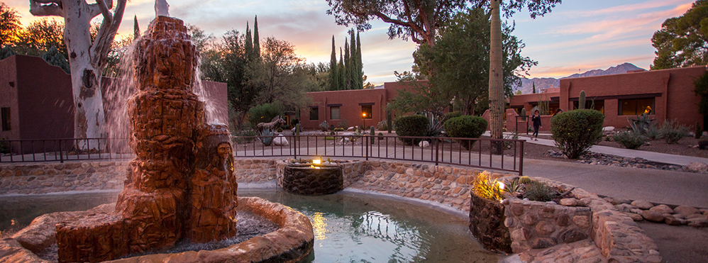
Case Study: Canyon Ranch
Click the following links to learn more about Canyon Ranch.
https://www.youtube.com/watch?v=8azawK81rDE
https://www.youtube.com/watch?v=O9ESLI5gevU
https://www.youtube.com/watch?v=tZ2L8q1ZozA

Slide 4
Spectrum of Health and Wellness Tourism
Physical Healing | Beauty Treatments | Relaxation/ Rest | Leisure/ Entertainment | Life/Work Balance | Psychological | Spiritual
Medical spas/baths | Cosmetic surgery trips | Pampering spas/baths | Spa resorts with ‘fun waters’ | Holistic centers | Holistic centers | Meditation retreats
Mofetta | Hotel/day spas | Wellness hotels | Sport/ fitness holidays | Occupational wellness workshops | Workshops (e.g. Hoffman, psycho-drama) | Yoga centers
Surgery trips |  | Thalassotherapy centers |  |  |  | Pilgrimage
Source: developed from Smith, M., & Puczkó, L. (2008). Health and wellness tourism. Routledge.

Slide 5
Spas
Guests who visit spas have the following characteristics:
A life full of intense anxiety, workload, and insecurity
Look for more intensive experience of relaxation and rejuvenation
Wish to restore a balance between work and private life
High disposable income
Requirements to enjoy personal service and care, cleanliness, hygiene, and a pleasant atmosphere
People who visit spas are typically motivated:
An increased orientation to a healthy and aesthetic body
A general desire for a healthier lifestyle (healthy nutrition)
Quest for spiritual experience (meditation and yoga)
Pursuit of happiness (as perceived by everyone)
The desire to look ‘sexier’ and healthier
Increasing demand for non surgical treatments

Slide 6
Spas
Places devoted to overall well-being through a variety of professional services that encourage the renewal of mind, body and spirit
Aristocrats
Explorers
Socializers
Budgeters

Slide 7
Spas
Type of Spa | Description
Club Spa | Primary use: fitness; also offers professional spa services
Cruise ship Spa | Spa on a cruise ship that offers professional spa services, fitness, and wellness; also offers spa menu with carefully chosen meals
Day Spa | Offers professional spa services daily; best examples of these spas are in western Europe
Destination Spa | Offer guests the opportunity to improve lifestyle and health through professional spa services, fitness, education, and accommodation all within the spa
Medical Spa | Integrates spa services with conventional treatments and therapies to give guests a complete health and wellness experience
Mineral Springs Spa | Uses minerals, thermal or springs, or hydrotherapeutic in its spa services; most European spas are this type of spa
Resort/Hotel Spa | Similar to cruise ship spa in that it offers professional spa services, fitness, and wellness at a resort/hotel/
Adapted from Table 1 in Vukovic, P., Cavlin, G., and Cavlin, M. (2015). Complementarity in the development of rural tourism with the development of thermal baths, spa and wellness tourism. Economics of Agriculture, 62(1). 259 – 270.

Slide 8
Active Exploration
Many people around the world, especially in developed Western economies, lack the level of activity in their everyday lives necessary to remain healthy
Any activity that keeps the body moving helps to maintain physical health

Slide 9
Thalasso and Thermal/Mineral Springs
Thalassotherapy is the therapeutic use of seawater, marine algae and marine mud in various body treatments
Thermal/mineral springs, or hot springs, are naturally occurring thermal springs of water hotter than 98°F (37°C)
Discussion:
Find thermal/mineral spring business/location and introduce it to the class in terms of its characteristics, benefits, customer segments etc.

Slide 10
Types of Thermal/Mineral Springs Establishments
Primarily Recreational | Primarily Wellness | Primarily Therapeutic or Curative
Thermal/mineral water swimming pool facilities | Thermal/mineral water bathing facilities | Health resorts and sanatoria that use thermal/mineral waters for treatments
Thermal/mineral water-based waterparks | Thermal/mineral water-based spas
Hotels/resorts with thermal/mineral water swimming pools | Thalassotherapy spas and resorts
Thermal or hot springs resorts

Slide 11
Yoga and Meditation
Yoga and meditation tourism focuses on the mind-body connection, with a spiritual aspect incorporated for some practitioners
There are many forms of yoga, such as hatha, bikram/hot yoga, iyengar, restorative, anusara, vinyasa, and ashtanga, and practices often include or are supplemented by a period of meditation
Yoga tourism is when a guest travels to a destination to engage in the practice of yoga and yoga-related activities to enhance their physical, mental and spiritual well being.

Slide 12
Yoga and Meditation
Type of Yoga | Brief Description
Hatha | Generic term used for any form of yoga that focuses on posture
Bikram | Walks through 26 yoga poses in a heated room
Hot Yoga | Similar to Bikram but this style uses different poses than Bikram, so they use a different name
Iyengar | Focuses on finding proper alignment in each pose. This type of yoga uses props like chairs or blocks to aid users in finding proper alignment.
Restorative | Use passive poses so the user can experience the benefits of a pose without physical effort
Anusara | Type of yoga that allows students to experience grace and open their hearts
Vinyasa | Known for fluid movement and smooth transitions between poses
Ashtanga | Rigorous form of yoga that connects each pose with a breath and focuses on posture. This type of yoga is completed the same way every time.
Adopted from Gaiam. (n.d.). A beginner’s guide to 8 major styles of yoga. Retrieved January 5, 2020, from https://www.gaiam.com/blogs/discover/a-beginners-guide-to-8-major-styles-of-yoga

Slide 13
Spiritual Hospitality and Tourism
Specific Drivers
Wellness and Healing
Personal Development
Personal Quest
Socialization
Journeying
Recreation/Leisure
Specific Drivers
Religious Observance
Ritualized Practice
Special Occasion
Socialization
Identity
Cultural Practice
Secular
Hybrid
Religious
Spirituality Religiosity
Focus on
Self
Focus on Institution
Commoditized Institutionalized

Slide 14
Holistic Tourism
Holistic tourism encompasses treatments or activities that encourage self-transformation through balancing the mind, body, and spirit
Because of the diversity required for this approach, holistic tourism is often practiced through retreats or other full-featured itineraries

Slide 15
Medical Tourism
Medical tourists fall into one of the four following categories:
Dedicated – has pre-determined treatment plan and traveling mostly for treatment;
Hesitant – decide on the treatment option after arriving at the medical tourism destination yet traveling primarily for treatment;
Holidaying – has pre-determined treatment plan, however, traveling mostly for pleasure, and;
Opportunistic – decide about the procedure after arrival and traveling primarily for pleasure

Slide 16
Comparing Medical Tourism and Wellness Tourism
 | Biomedical Health Paradigm | Wellness Health Paradigm
Definition of health | Absence of disease Separation of mind and body (‘body as machine’ metaphor) | Positive functioning; a balance between internal and external forces Oneness of body/mind/spirit (body as part of an integrated, multidimensional system) interlinked with external system
Definition of disease | A biological process where pathogens damage the ‘body machine’ | A systemic imbalance, mostly not reducible to a single biologic cause
Relationship between health and disease | Health and disease are dichotomous opposites Health and disease are objective, observable phenomena | Health and disease are two separate dimensions Health and disease are subjective and perceptual phenomenon
Focus of health care | Short-term focus on curing or alleviating disease symptoms | Long-term focus on health prevention
Characteristics of health care and intervention process | Standardized care High tech/low touch Intervention focuses on invasive procedures, pharmaceutical drugs and high-tech diagnostics Consultation is paternalistic | Individualized care Low tech/high touch Intervention emphasizes non-invasive procedures, lifestyle-based interventions, ‘self-healing’ and herbal medicines Consultation is participatory, empowering, and empathic
Role of patient | Patient remains largely passive, authority is inherent in the health professional | Patient must assume self-responsibility and needs to become an active participant
^{Source:} Developed from Voigt, C. (2014). Towards a conceptualization of wellness tourism. Wellness tourism: A destination perspective, 19-44.

Slide 17
Occupational Wellness
Workplace wellness “includes expenditures on programs, services, activities and equipment by employers aimed at improving their employees’ health and wellness
An individual’s work-life balance determines how much time they spend at or thinking about work, versus how much time they dedicate to their family and personal life

Slide 18
Summary
Health tourism is using services to improve physical or psychological health with the help of mineral water springs, climatic conditions, or medical intervention in an area outside one’s place of residence for more than 24 hours and less than one year.
Spas are places devoted to overall well-being through a variety of professional services that encourage the renewal of mind, body, and spirit.
Guest who visit spas often share the following characteristics: “(i) a life full of intense anxiety, workload, and insecurity, (ii)look for more intensive experiences of relaxation and rejuvenation, (iii) a wish to restore a balance between work and private life, thus improving quality of life, (iv) a high disposable income and willingness to reward themselves by visiting a wellness and spa centre, (v) requirements to enjoy personal service and care, cleanliness, hygiene and a pleasant atmosphere, reasonable waiting time for using equipment and facilities, and finally, continuous presence and support by skillful staff.”

Slide 19
Summary
The people who visit spas are typically motivated by “(i) an increased orientation to a healthy and aesthetic body, (ii) a general desire for a healthier lifestyle (healthy nutrition), (iii) the quest for spiritual experiences (meditation and yoga), (iv) the pursuit of happiness (as perceived by everyone), (v) the desire to look ‘sexier’ and healthier, and (vi) an increasing demand for non-surgical treatments
There are four broad categories of hotel spa tourists: Aristocrats, Explorers, Socializers, and Budgeters.
There are seven types of spa/wellness capacities: club, cruise ship, day, destination, medical, mineral, and resort/hotel.

Slide 20
Summary
Thalassotherapy is the therapeutic use of seawater, marine algae, and marine mud in various body treatments.
Thermal/mineral springs, or hot springs, are naturally occurring thermal springs of water hotter than 98 degrees F.
Yoga is the union of the body, mind, and spirit and grants stress relief through meditation, physical postures, and breathing techniques.
The eight different types of yoga are hatha, bikram, hot yoga, iyengar, restorative, anusara, vinyasa, and ashtanga.
Yoga tourism is when a guest travels to a destination to practice yoga and a yoga retreat is when the experience is planned and developed around yoga.

Slide 21
Summary
Spiritual hospitality and tourism is the act of visiting somewhere locally, nationally, or abroad to visit spiritual places such as mosques, churches or synagogues or natural environments like forests, oceans, or parks.
Holistic tourism encompasses treatments or activities that encourage self-transformation through balancing the mind, body, and spirit.
Medical tourism is the practice of visiting another location or country for medical care
Medical tourists fall into four categories: dedicated, hesitant, holidaying, or opportunistic.
Workplace wellness includes expenditures on programs, services, activities, and equipment by employers aimed at improving their employees’ health and wellness.

